Slide 1
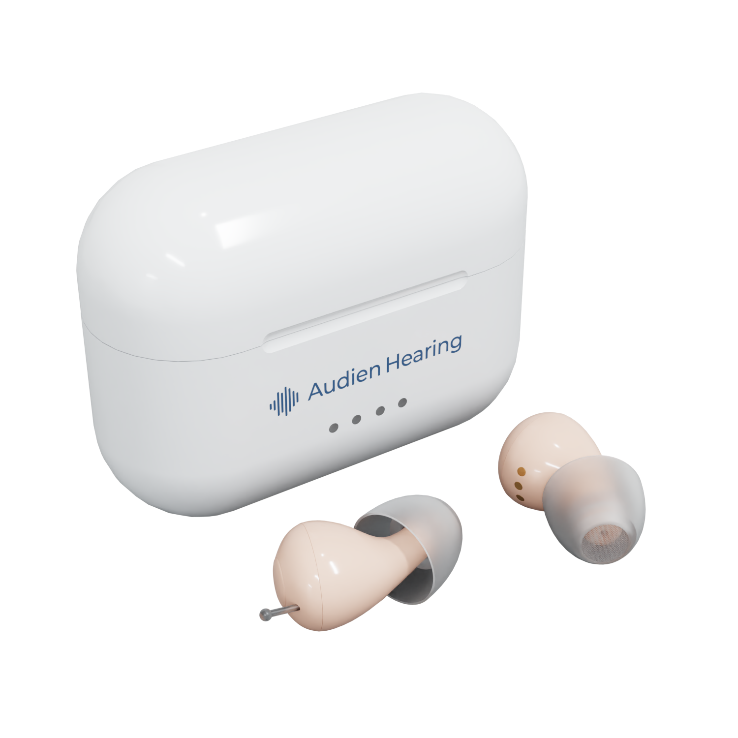
Bridging The Gap: Why OTC Hearing Brands & The Medical Community Need To Work Together
Ishan Patel, Founder & CEO,
Audien Hearing

Slide 2
ABOUT Ishan Patel
CEO and Founder of Audien Hearing
OTC hearing industry since 2018
Worked in many roles such as product testing, fulfillment, customer service, and phone sales
Scaled Audien Hearing to 500,000+ customers
Developed several custom hearing products with innovative features and competitive prices

Slide 3
The hearing aid market is growing FAST
From 2023 to 2030, the $12B hearing aid market is projected to grow 75% to $21B at a CAGR of 8.4%
Majority of the market is still traditional hearing aids
We’ve yet to scratch the surface of how OTC will affect hearing aid market growth
Source: https://www.globenewswire.com/en/news-release/2023/08/21/2728482/0/en/Hearing-Aids-Market-Size-to-Surpass-USD-21-09-billion-by-2030-exhibiting-a-CAGR-of-8-4.html#:~:text=As%20per%20the%20report%20by,8.4%25%20during%20the%20forecast%20period

Slide 4
The state of the hearing industry
The big problem:
The hearing consumer is massively underserved
More than 80% of people with hearing loss don’t wear hearing aids
Lack of consumer education on options
It takes 7+ years on average for someone to buy a hearing aid
Brain degeneration (increased risk of cognitive decline, Alzheimer’s, dementia)
The Solution:
Affordability and accessibility

Slide 5
Hearing aid buyers are getting younger
The average hearing aid user is aged 74+
Audien’s average customer is age 55
25% of customers are buying for someone else
Hearing aid market segments
65-75+: Average traditional hearing aid user
50+: OTC hearing aid users
20-50: Buying hearing aids for someone else
Source: https://www.google.com/url?sa=t&rct=j&q=&esrc=s&source=web&cd=&ved=2ahUKEwi1zujX8eeCAxUcM0QIHfWED0EQFnoECBEQAw&url=https%3A%2F%2Fwww.ncbi.nlm.nih.gov%2Fpmc%2Farticles%2FPMC3665209%2F%23%3A~%3Atext%3DFor%2520those%2520who%2520are%2520candidates%2CDavis%2520et%2520al%252C%25202007).&usg=AOvVaw13ZgeIvOivrTlCQ8SnI0K2&opi=89978449

Slide 6
Consumers in the OTC world –
reducing the barrier to entry
These are the customers that currently walk out the door without buying
Traditional products are too complex, too big, too expensive… especially for new entrants to the hearing market
These customers will buy more expensive products as they move up the value chain over time
How does the hearing experience compare to other consumer products they use daily?
Consumers crave simple products that work for them
.
Commodities like the TV, the cell phone, etc.
What matters most to them (in order of importance)?
Price
Size
Comfort
Ease of use
Sound quality

Slide 7
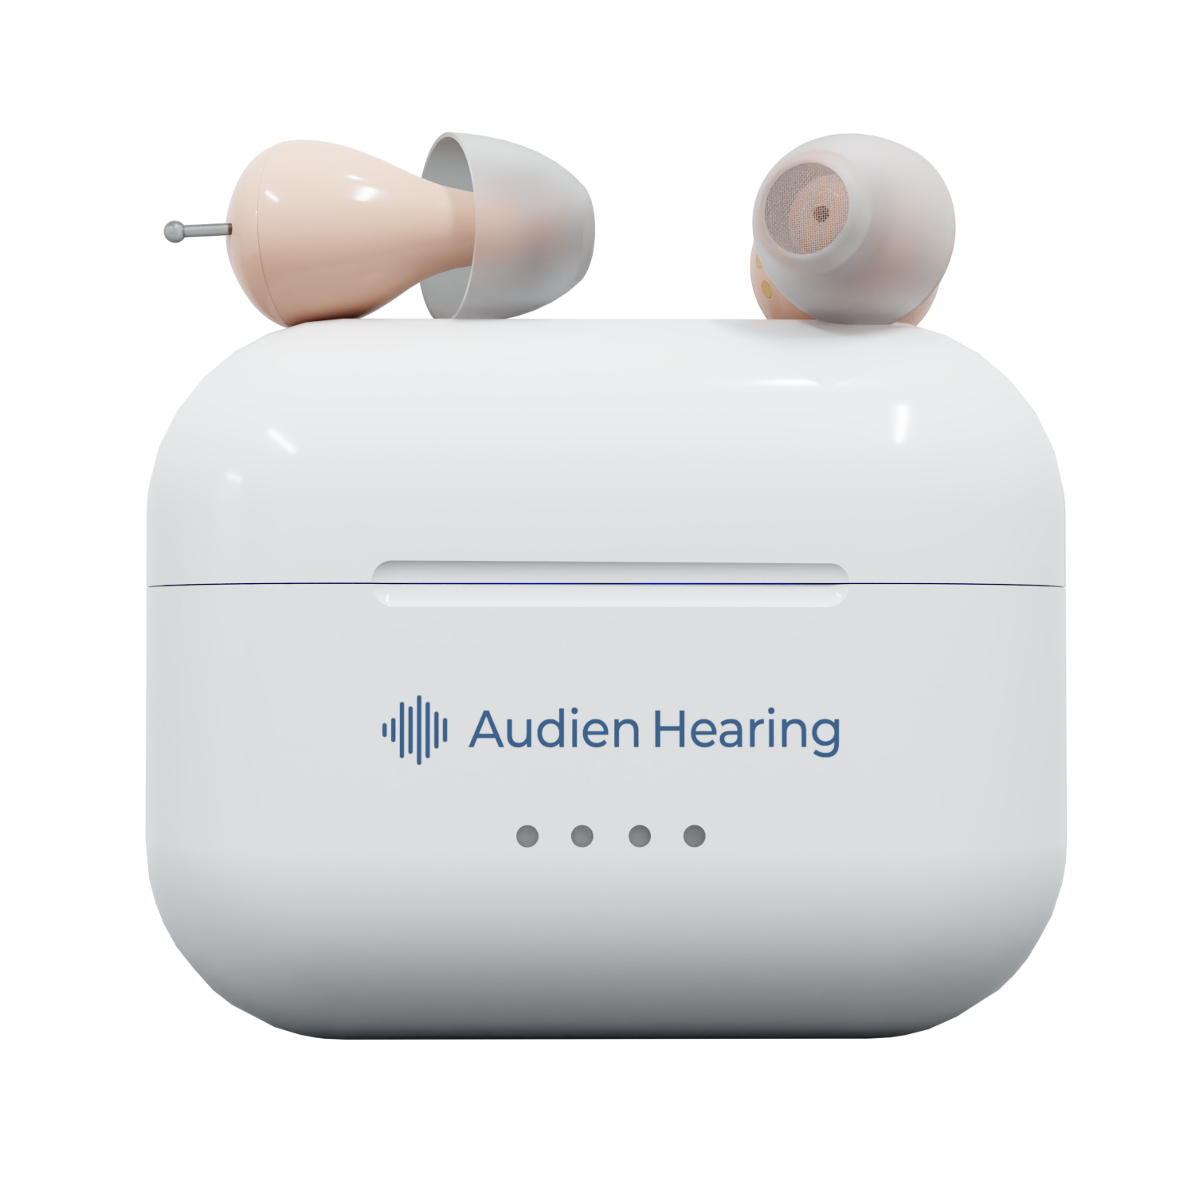
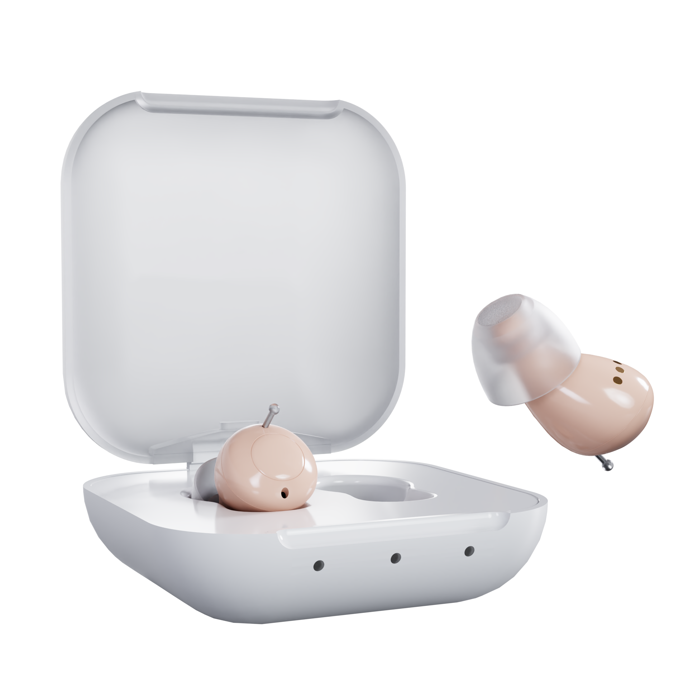
OTC hearing products consumers want
Atom Pro 2
Atom 2
Rechargeable, easy to use, affordable CIC
People want discreet hearing aids that get the job done
Walmart: Atom One OTC hearing aid for $98

Slide 8
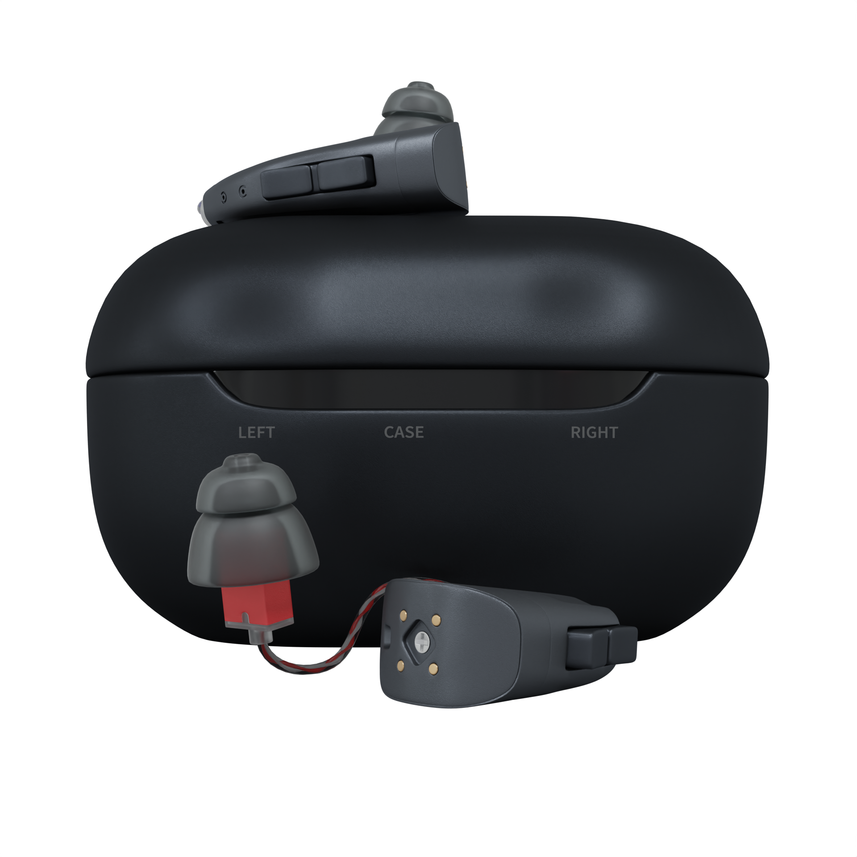
OTC hearing products consumers want
ion pro
ion
Product innovation on RICs
RIC tech is getting better and prices are getting lower
Easy to use
Self fitting
Bluetooth /app controlled
Telehealth

Slide 9
OTC is an opportunity, not a risk
Lowers barrier to entry and time to purchase
On average, an Audien customer purchases a hearing aid within 5 days of first interacting with our brand
Customers repeat purchase more frequently
Audien has a 15% repurchase rate in just 3 years
Opens the door for premium products over customer lifecycle

Slide 10
Why OTC brands & patients need doctors
Doctors are the 2nd most trusted professionals in the world
What Audien has learned from fielding 20,000+ calls per month
Starting your hearing journey is very emotional
Customers are seeking guidance
Practitioners are the most qualified and relied upon
Notes:
https://news.gallup.com/poll/467804/nurses-retain-top-ethics-rating-below-2020-high.aspx

Slide 11
How OTC hearing brands and the medical community can work together
Step 1: increase market size and conversion rate by offering OTC options
Step 2: shorten buying cycle from 7 years to 7 days
Step 3: move patients up the value chain
Step 4: build lifetime customer relationships
Step 5: watch the referrals pour in

Slide 12
Conclusion
Medical professionals and OTC brands must work together to serve as many patients as possible
Audien has the brand, product, and service needed to be the bridge

