Slide 1
Factors influencing hearing help-seeking, hearing aid uptake and outcomes of hearing aids
Vinaya Manchaiah, AuD, MBA, PhD
Professor @ University of Colorado School of Medicine
Director of Audiology @ UCHealth
Personal website: www.vinayamanchaiah.com
Lab website: www.virtualhearinglab.org

Slide 2
Collaborators
Megan Knotze
PhD Student
University of Pretoria
Bopane Mothemela
PhD Student
University of Pretoria
Faheema Mahomed-Asmail
Associate Professor
University of Pretoria
De Wet Swanepoel
Professor of Audiology
University of Pretoria

Slide 3
Acknowledgements
Academic Partners
www.virtualhearinglab.org
Industry Partners

Slide 4
Funding / Conflict of Interest
Scientific advisor of the hearX group
Funding from the University of Colorado, the National Institute of Health (NIH), William Dement Foundation, and Sonova Holding AG.
Travel expenses were covered to attend this seminar

Slide 5
Learning Outcomes
1. Describe benefits of hearing aid use in adults with hearing loss
3. Discuss factors influencing hearing aid uptake in adults with hearing loss
2. Discuss reasons why people may or may not seek hearing help
4. Discuss factors influencing hearing aid use and benefit/satisfaction in adults with hearing loss

Slide 6
Outline
1. Background information
4. Key factors influencing hearing health outcomes
5. Summary
2. Behavior change theories
3. Hearing aid outcomes

Slide 7
1. Background information

Slide 8
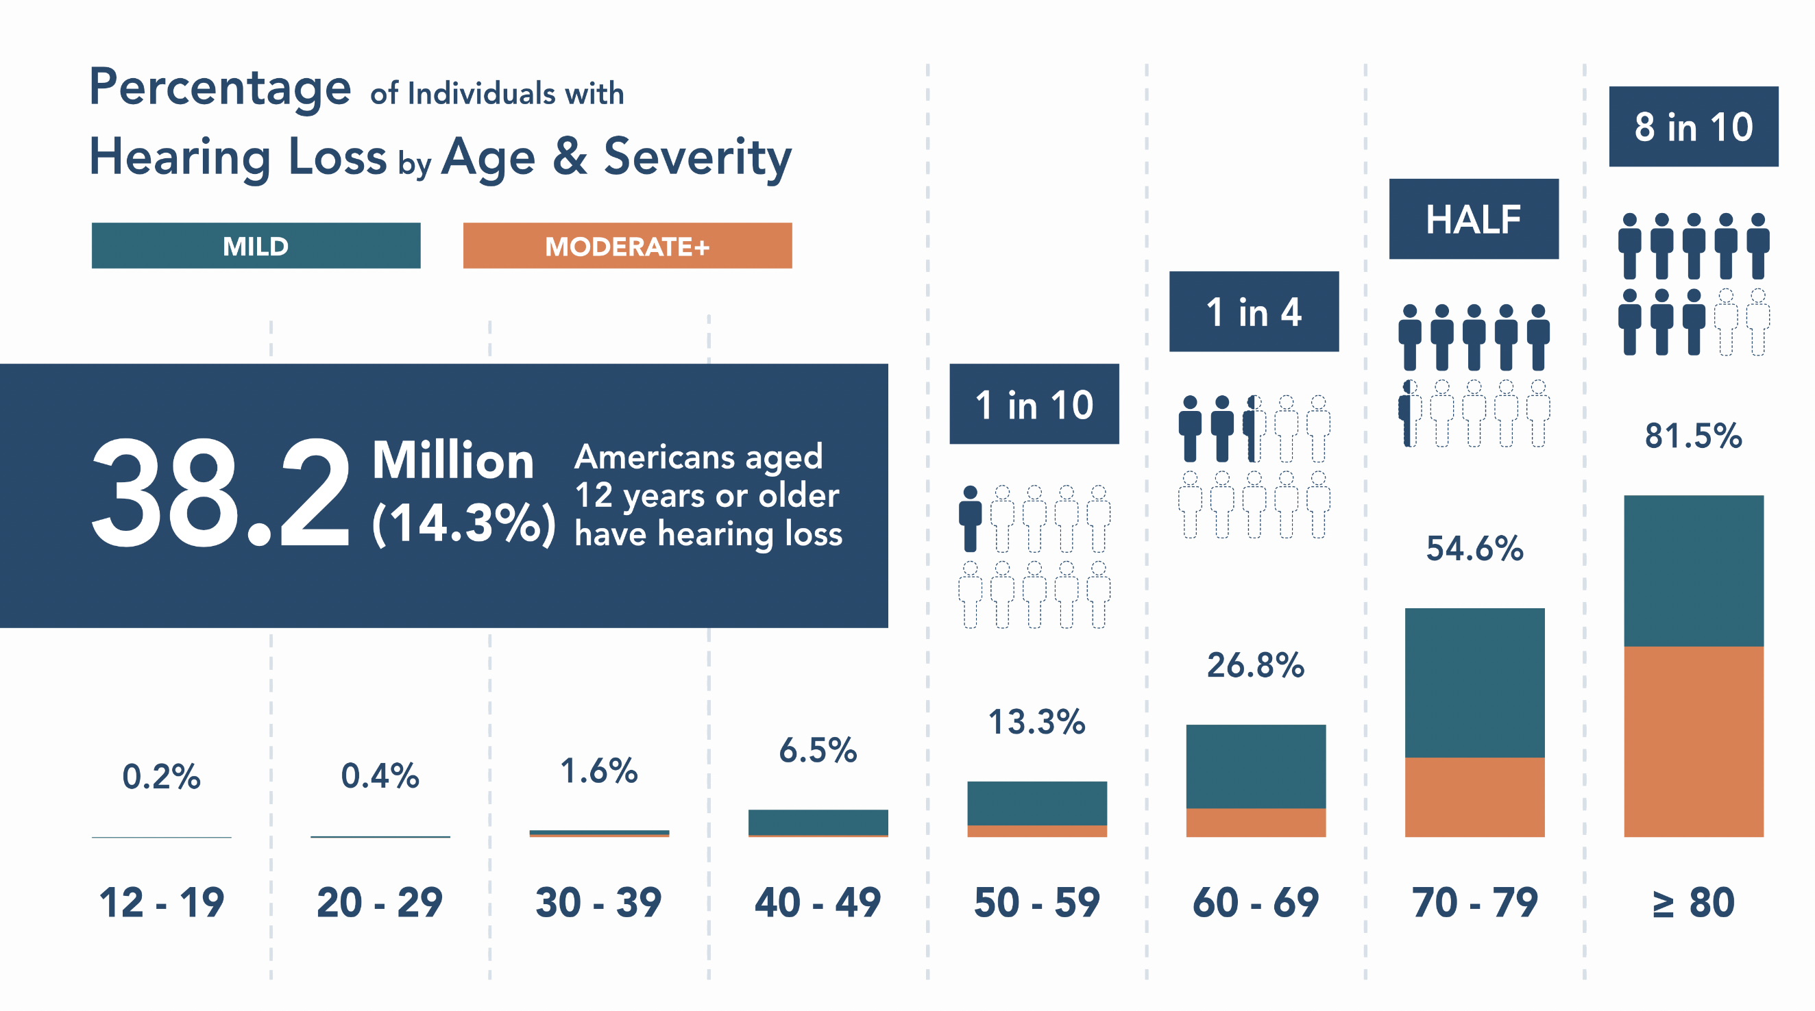

Slide 9
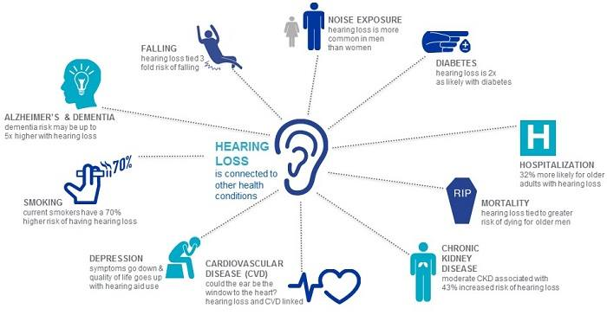

Slide 10
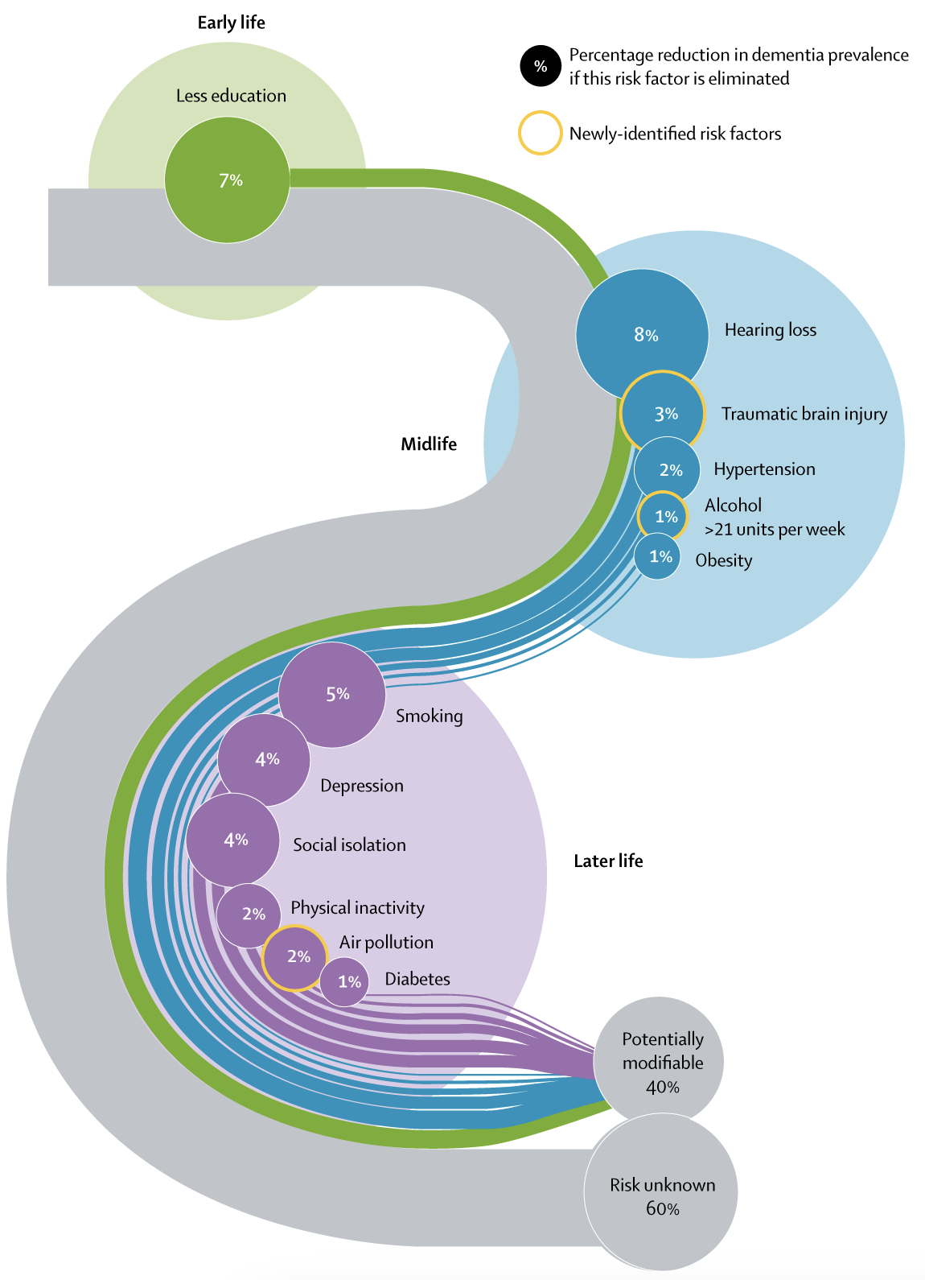
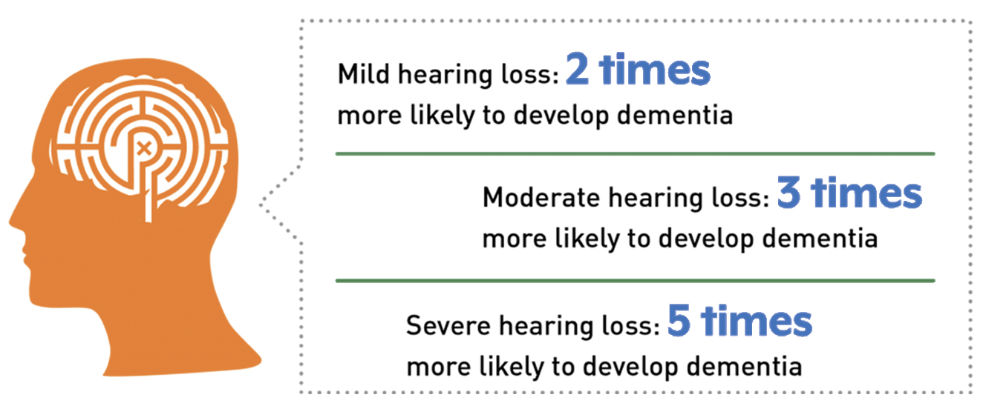
Dementia and Hearing loss

Slide 11
Hearing Aids and Cognitive Decline
Hearing aids slow cognitive decline in older adults with high risk for cognitive decline
Aging and Cognitive Health Evaluation in Elders (ACHIEVE) study: https://www.achievestudy.org/

Slide 12
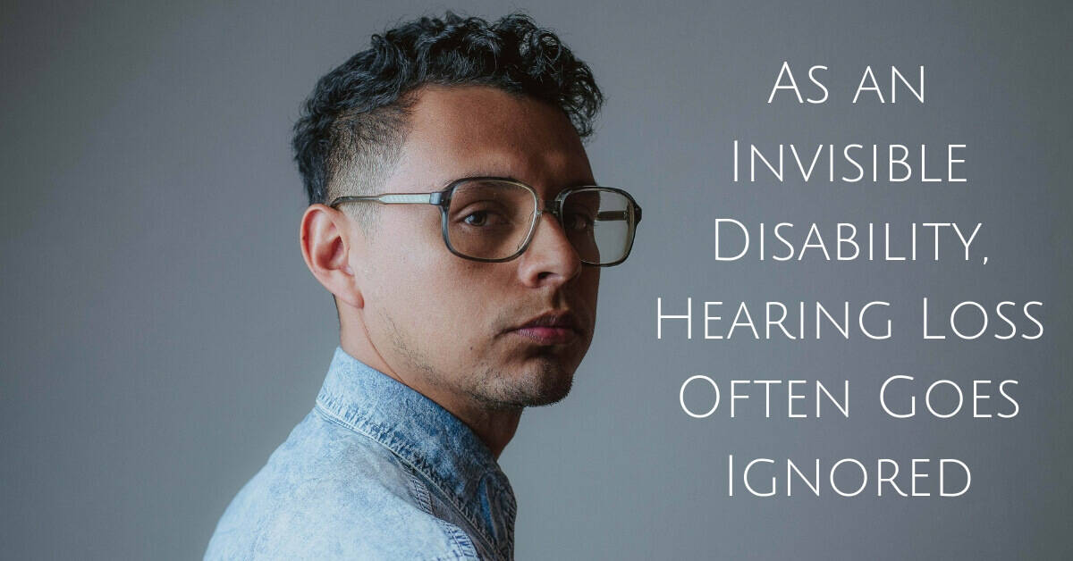
People take an average of 7-10 years to realize hearing loss and purchase hearing aids

Slide 13
Hearing aid uptake in the Unites States
First time hearing aid users take on an average 7-10 years to purchase their first hearing aid
Estimates suggest 25% of people with hearing loss own hearing aids

Slide 14
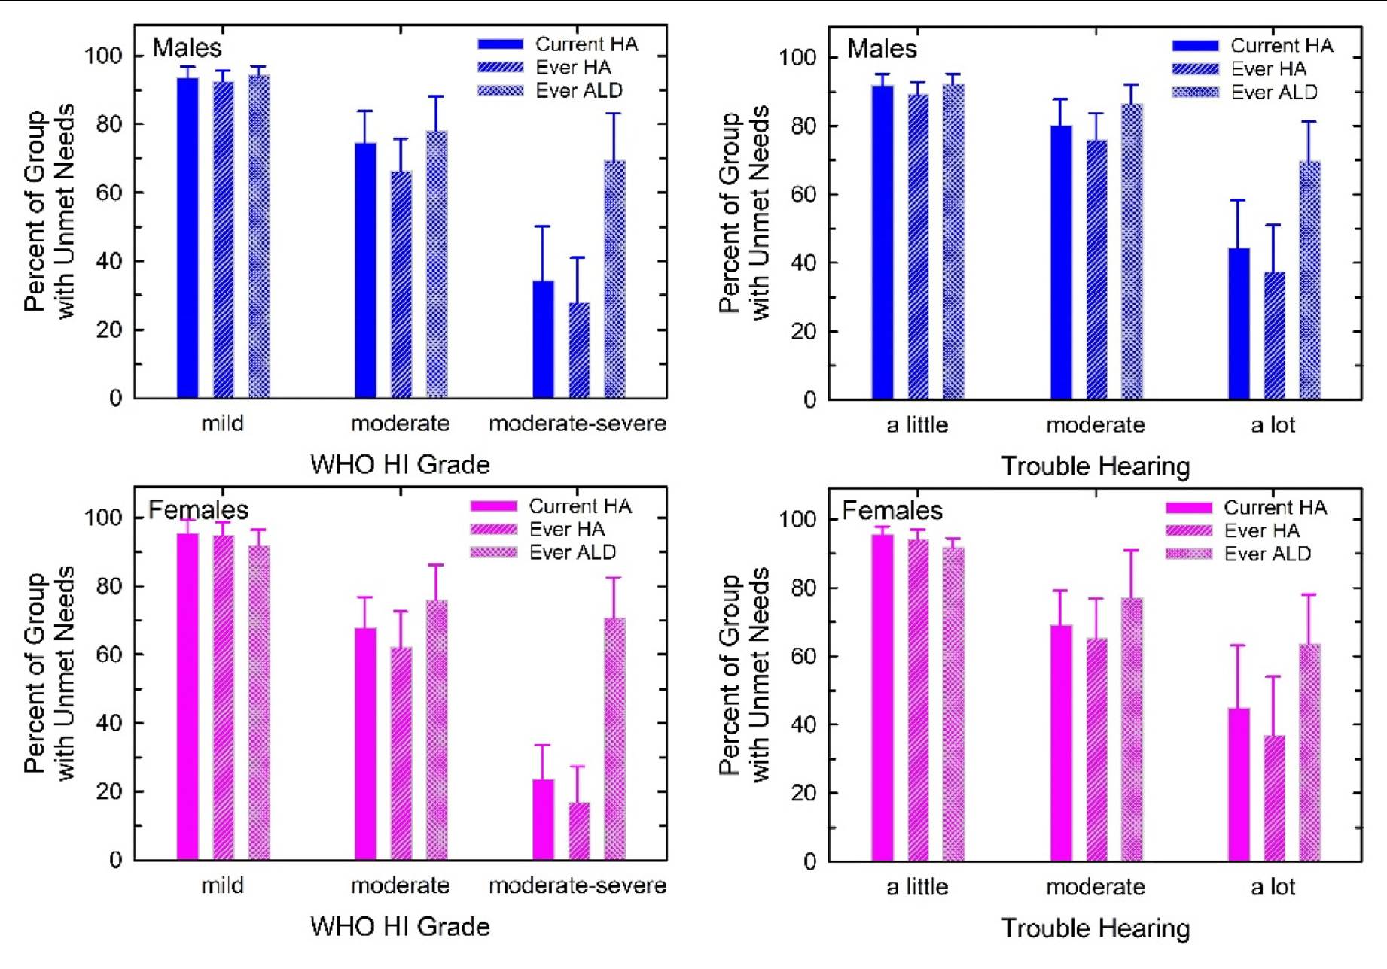
Unmet hearing healthcare need
Humes (2023) Trends in Hearing
Notes:
https://www.audiologist.org/events/quick-links/ada-webinars/item/defining-the-addressable-market-of-otc-vs-prescription-hearing-aids
https://www.audiologist.org/events/quick-links/ada-webinars/item/empowering-adults-to-manage-their-hearing-problems-and-how-audiologists-can-help

Slide 15
2. Behavior change theories

Slide 16
Behavior change theories
Transtheoretical (Stages of change) model
Health belief model
Protection motivation theory
Theory of reasoned action
Theory of planned behavior
Self-determination theory

Slide 17
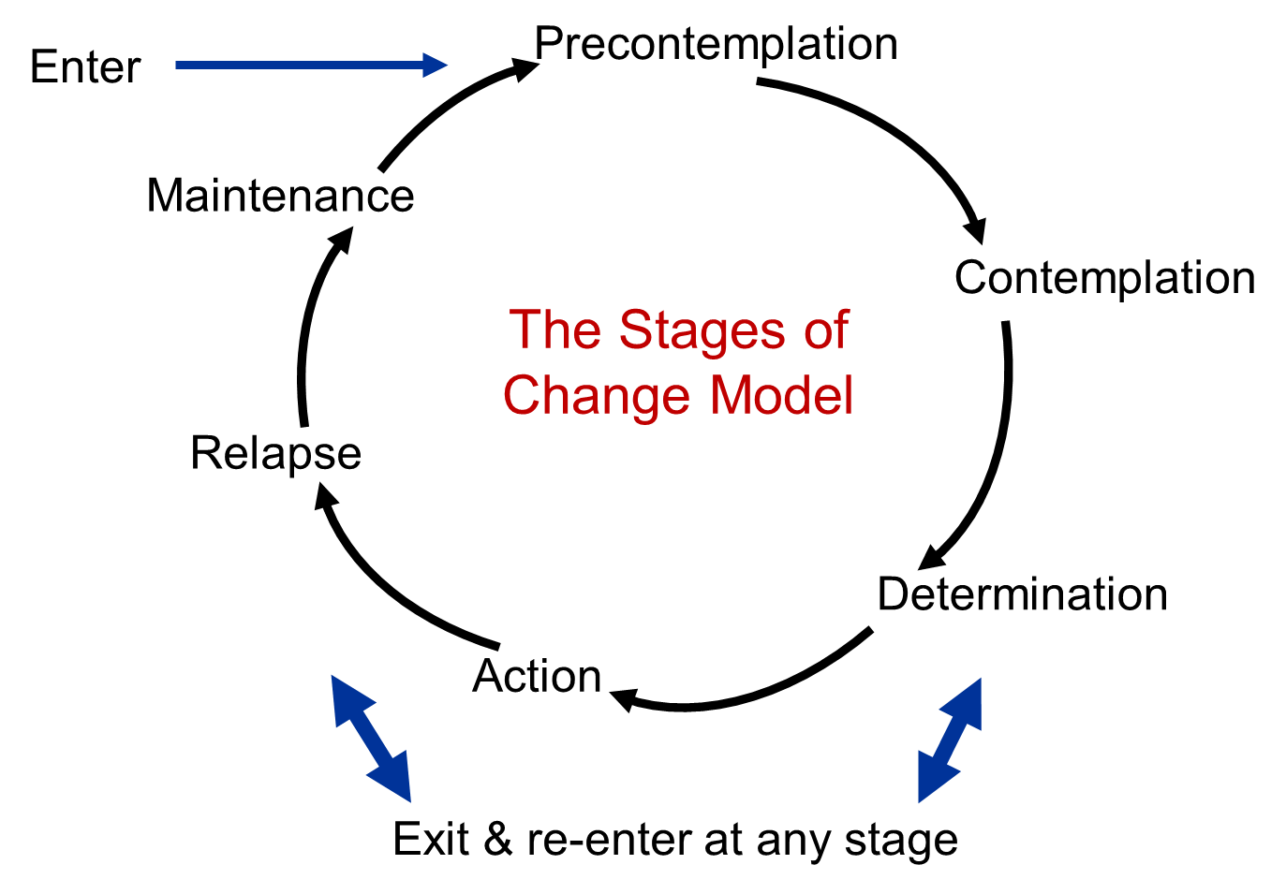
Transtheoretical (Stages of change) model

Slide 18
Patient’s journey of adults with acquired hearing loss (Manchaiah et al., 2011)

Slide 19
3. Hearing aid outcomes

Slide 20
Hearing aid outcomes
Outcome: Something that follows as a result or consequence
Hearing aid outcomes
Hearing/ Communication
Anxiety/depression
Quality of life
Hearing aid outcome is measured in terms of “benefit” and/or ”satisfaction”

Slide 21
Hearing Aid Outcomes
Hearing aid benefit and satisfaction are strongly related, but they are two separate constructs (e.g., Wong et al., 2003).
Hearing aid benefit can be defined as improvement in hearing function and communication ability as a result of hearing aid performance.
Hearing aid satisfaction can be defined as a hearing aid user’s positive emotional appraisal of their hearing aid experience in the context of their expectations.

Slide 22
Hearing Health Outcomes
Help-seeking
Use
Benefit/
Satisfaction
Uptake

Slide 23
4. Key factors influencing hearing health outcomes

Slide 24
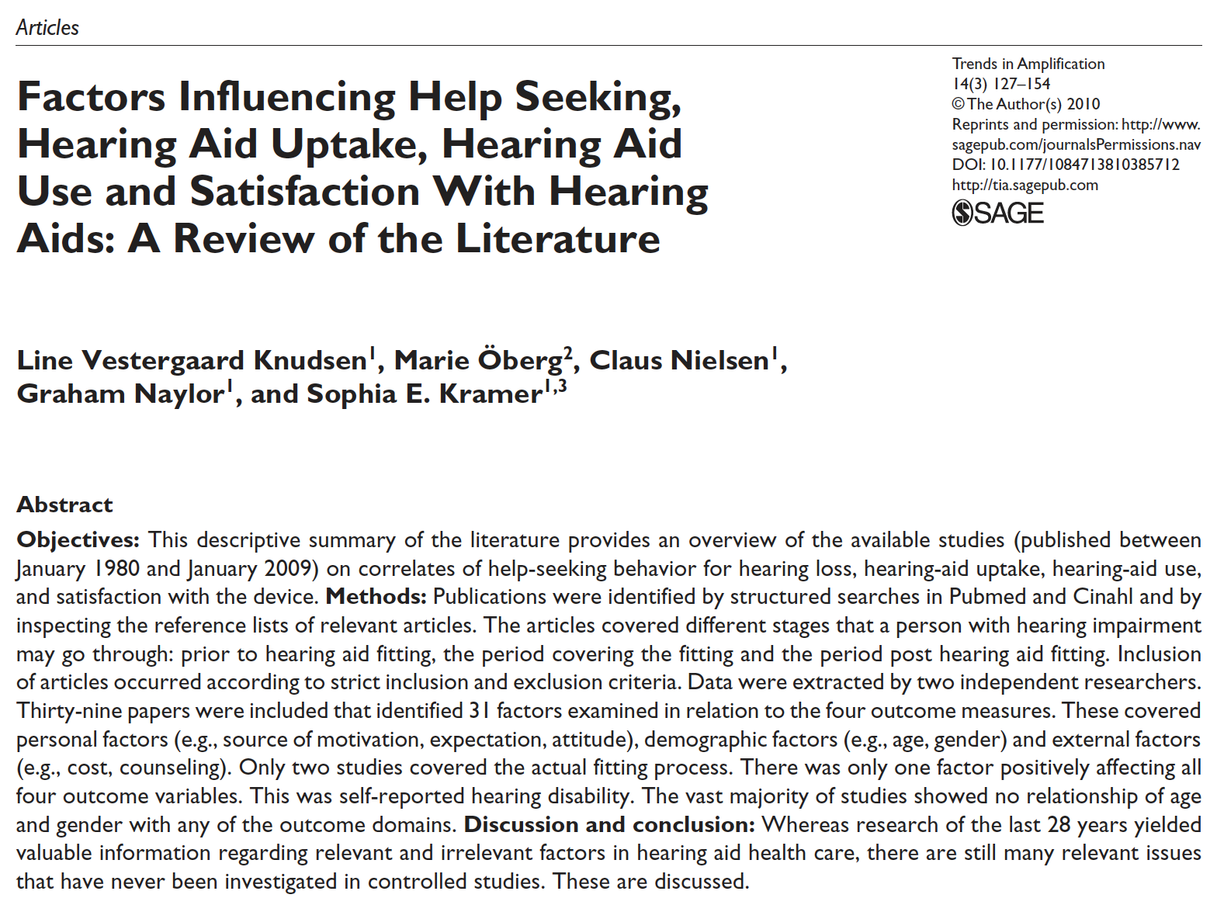

Slide 25
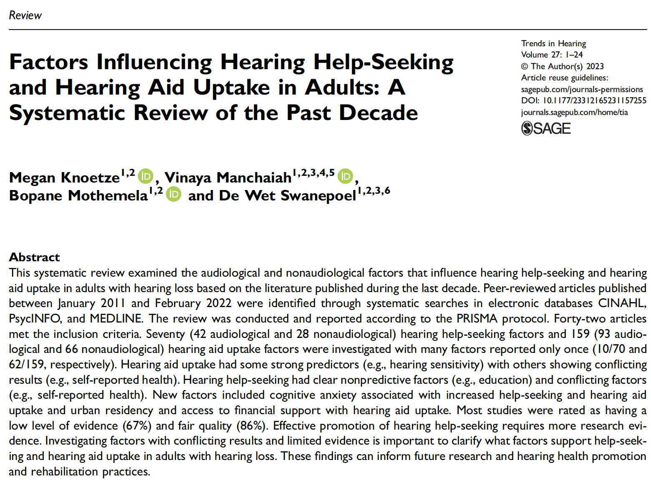

Slide 26
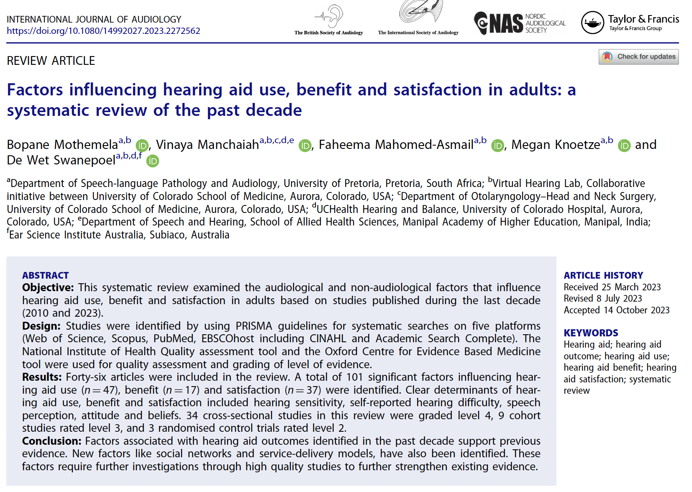

Slide 27
Systematic reviews
Knudsen et al. (2010) | Knoetze et al. (2023) | Mothemela et al. (2023)
Help seeking, Uptake, Use, Satisfaction | Help-seeking, Uptake | Use, Benefit, Satisfaction
1980-2009 | 2011-2022 | 2011-2022
39 manuscripts | 42 manuscripts | 46 manuscripts
4 outcomes: 31 | Help-seeking: 70 (42 + 28) | Use: 47
 | Uptake: 159 (93 + 66) | Benefit: 17
 |  | Satisfaction: 37

Slide 28
Factor classification
Knudsen et al. (2010)
Personal (source of motivation, expectation, attitude)
Demographic (age, gender)
External (cost, counseling)
Knoetze et al. (2023) and Mothemela et al. (2023)
Audiological (hearing sensitivity, speech perception)
Non-audiological (demographics, social network, health)

Slide 29
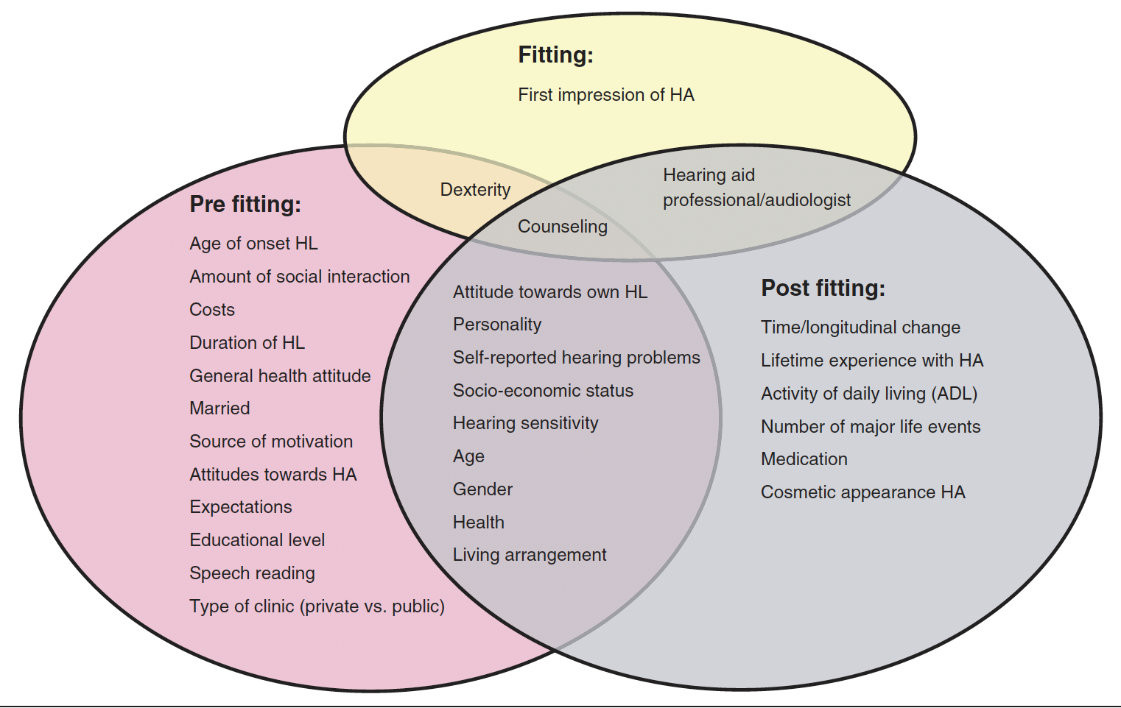
Possible factors

Slide 30
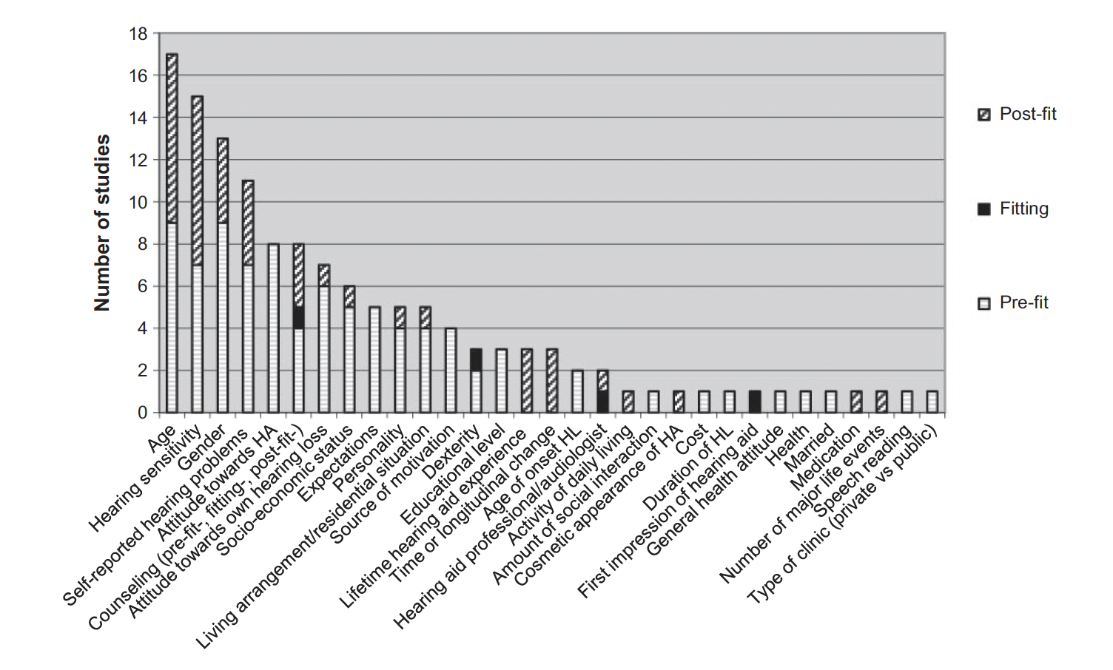
Number of studies per factor

Slide 31
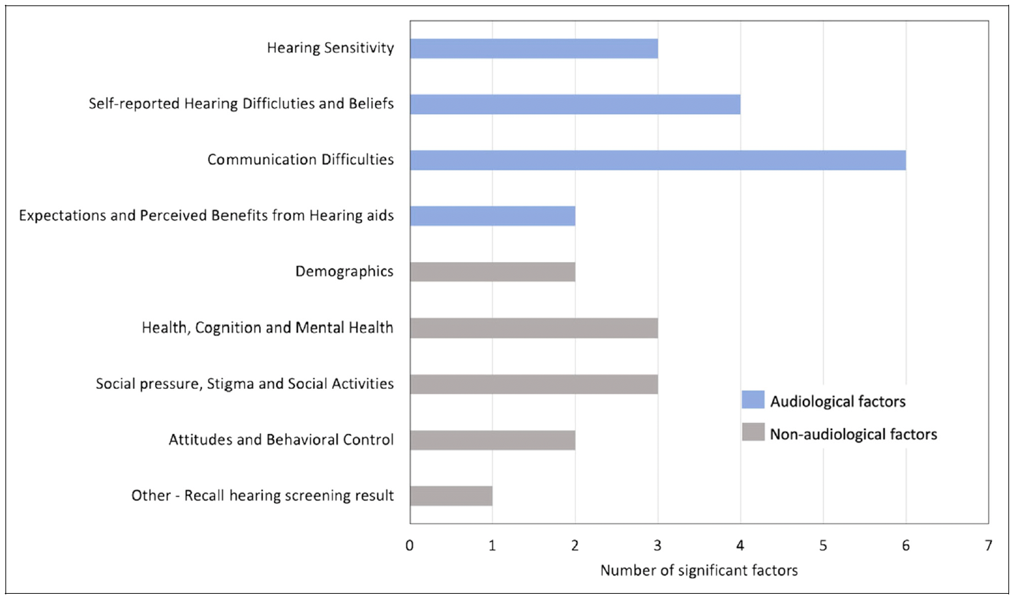
Factors influencing hearing help-seeking (Knoetze et al., 2023)

Slide 32
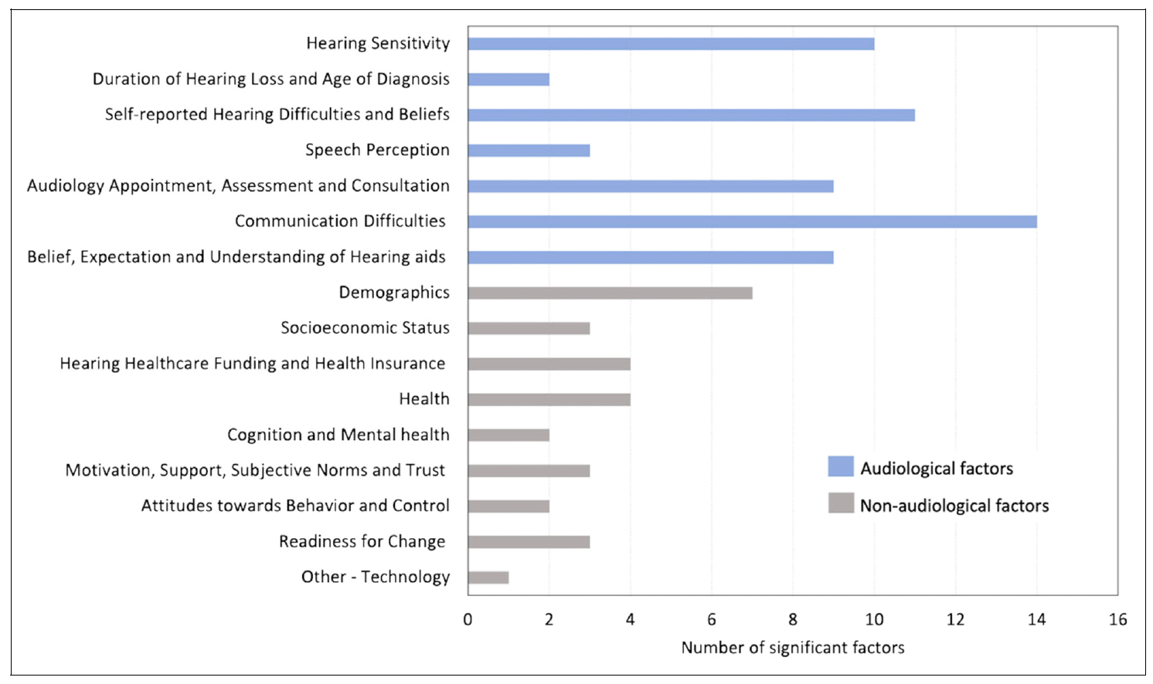
Factors influencing hearing aid uptake (Knoetze et al., 2023)

Slide 33
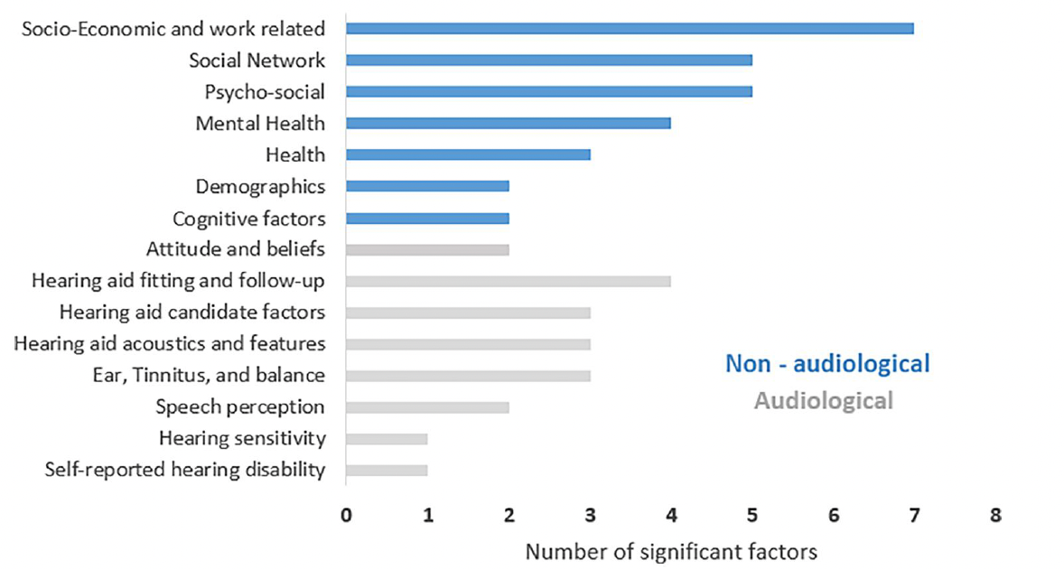
Factors influencing hearing aid use (Mothemela et al., 2023)

Slide 34
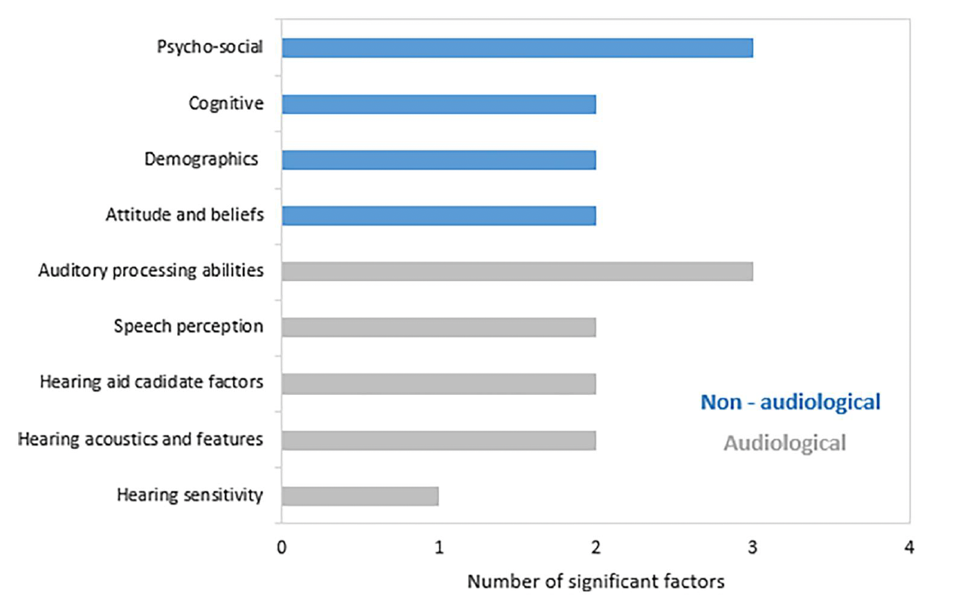
Factors influencing hearing aid benefit (Mothemela et al., 2023)

Slide 35
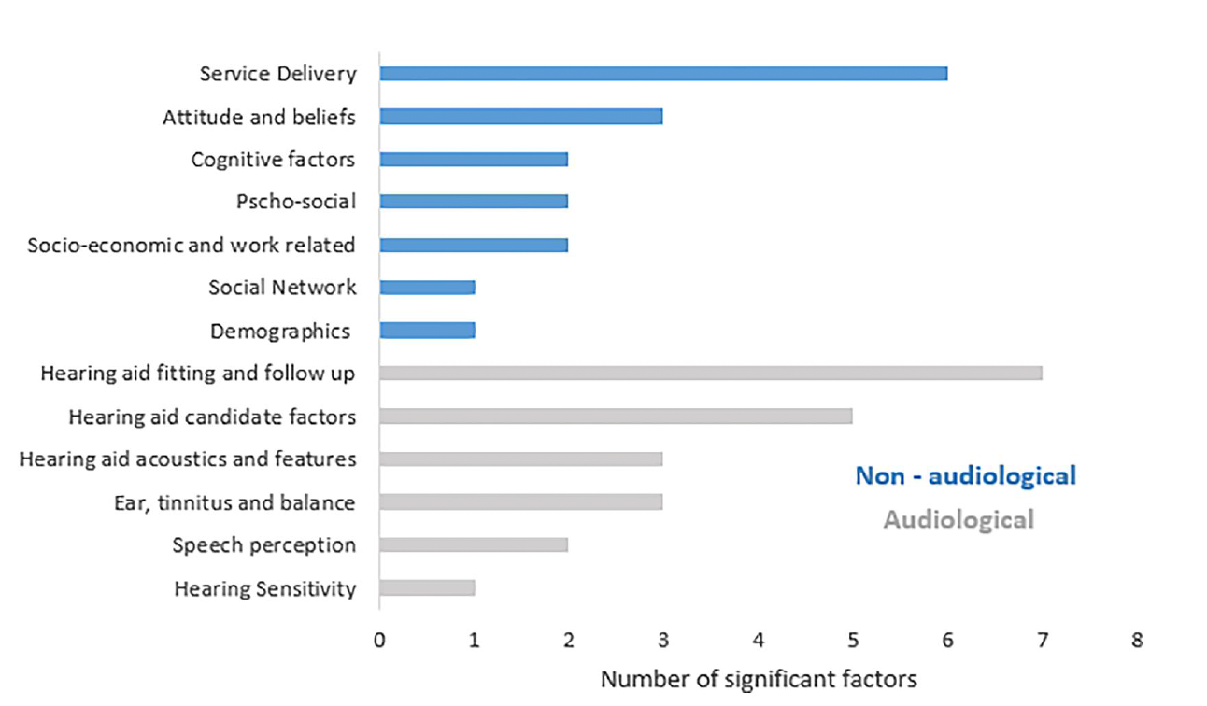
Factors influencing hearing aid satisfaction (Mothemela et al., 2023)

Slide 36
Audiological Factors
Factors | Help-seeking | Uptake | Use | Benefit/ Satisfaction
Hearing sensitivity (PTA) | + | + | + (0) | + (0)
Hearing disability (HHIE) | + | + | + | +
Communication difficulties | +
Speech perception (higher SNR loss) |  | + | + | +
Pre-fitting attitude and beliefs |  |  | + | +
Pre-fitting expectations | + |  | + (0) | + (0)
Counseling |  |  | + (0) | + (0)
Hearing aid use |  |  |  | +
Service delivery |  |  |  | 0

Slide 37
Non-Audiological Factors
Factors | Help-seeking | Uptake | Use | Benefit/ Satisfaction
Age | 0 | 0 | 0 | 0
Gender | 0 | 0 | 0 | 0
Socioeconomic status |  | 0 | 0 | 0
Living arrangement |  | 0 | 0 | 0
Self-reported health and mental health | 0 |  | 0
Urbane residency |  | +
Access to financial support |  | +
Cognitive factors | + | + |  | +
Social factors (social networks, social pressure, stigma) | + |  | +

Slide 38
5. Summary

Slide 39
Key Findings
Most studies were observational study design and fair quality
Most factors have single studies
Many factors have conflicting evidence
Hearing sensitivity, Self-reported hearing disability and Speech in noise problems are the most important audiological predictive factors
Cognitive factors and social networks are emerging non-audiological predictive factors

Slide 40
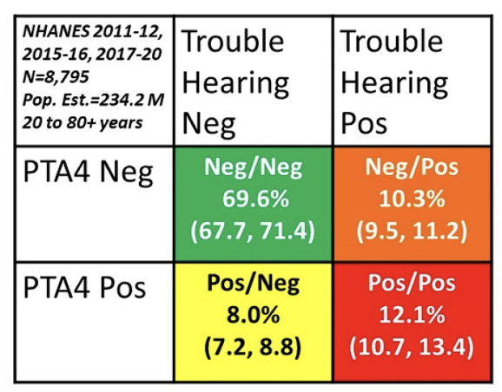
Relationship between hearing sensitivity and self-reported hearing disability (Humes, 2023)
Notes:
chrome-extension://efaidnbmnnnibpcajpcglclefindmkaj/https://www.ncbi.nlm.nih.gov/pmc/articles/PMC10084570/pdf/10.1177_23312165231160978.pdf

Slide 41
Thank You

