Slide 1

Sennheiser Hearing Portfolio
Jessica Dancis
Introducing
Notes:
We view early-entry solutions as a way of improving consumer access to hearing care, particularly in the early stages of the hearing journey. We believe that hearing care professionals will remain central to this market and many people with hearing loss will ultimately seek their support.
With our new Sennheiser Hearing Portfolio we provide products and services for HCPs to participate in new opportunities and to deliver their services to as many consumers as possible.

Slide 2
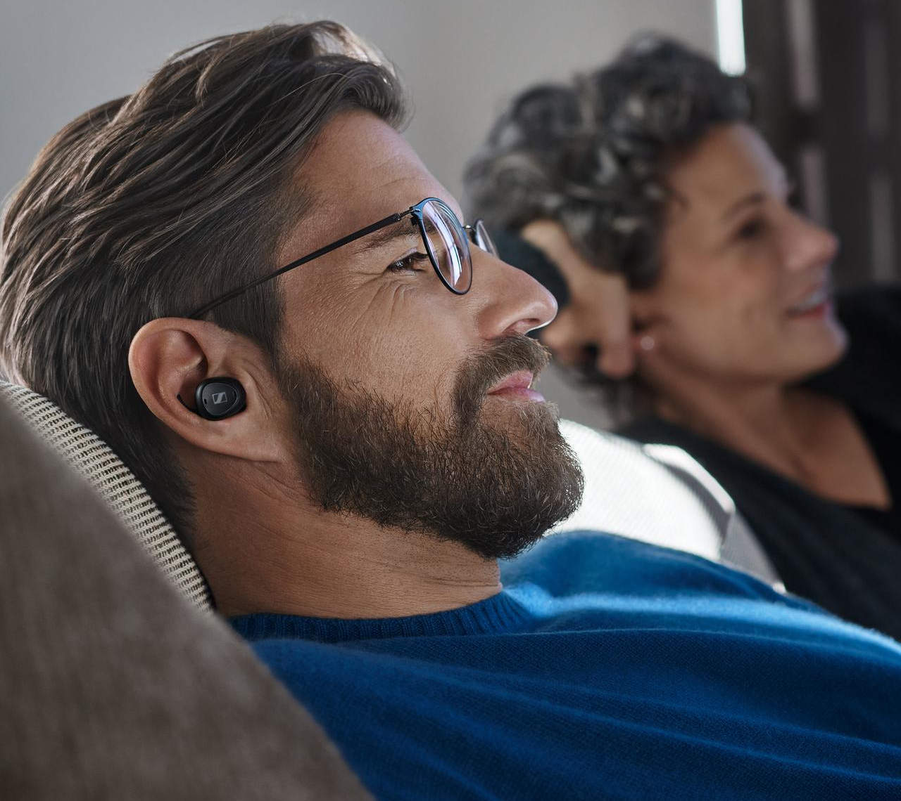


Sennheiser Portfolio: Solutions From situational hearing to all-day hearing support
TV Hearing
Conversation Hearing
All-Day Hearing
Effortless hearing when watching TV or listening to content on a mobile media device.
Improvement of the hearing in noisy environments where ability to distinguish speech is a challenge.
All-Day hearing aids are medical devices designed for individuals with a perceived mild to moderate hearing loss, for all-day wear in everyday environments
USE: MEDIA CONSUMPTION
USE: SITUATIONAL
USE: ALL-DAY
Notes:
Read slide
We make it easy.

Slide 3
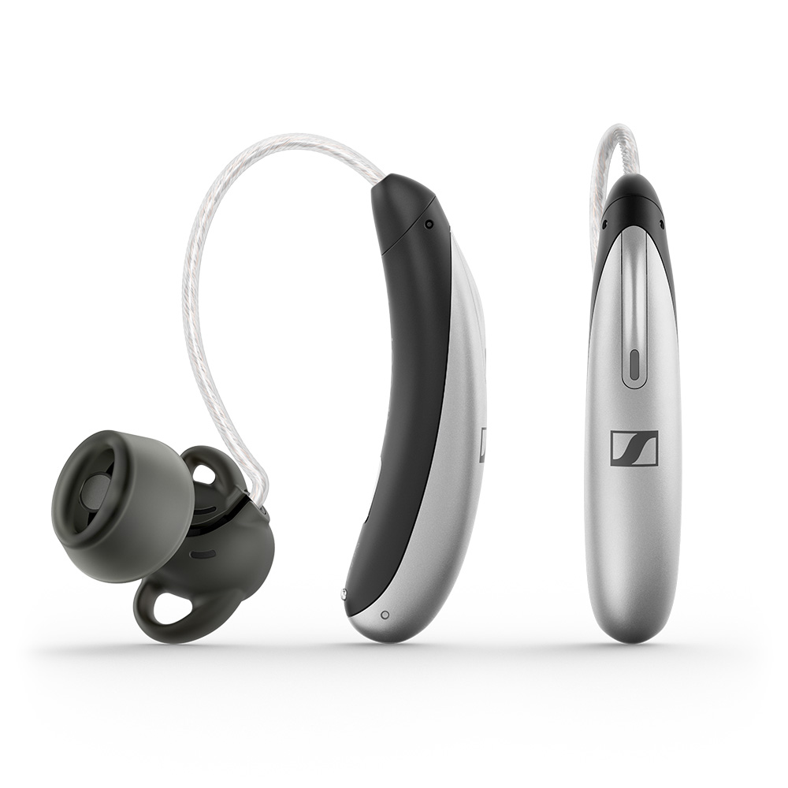
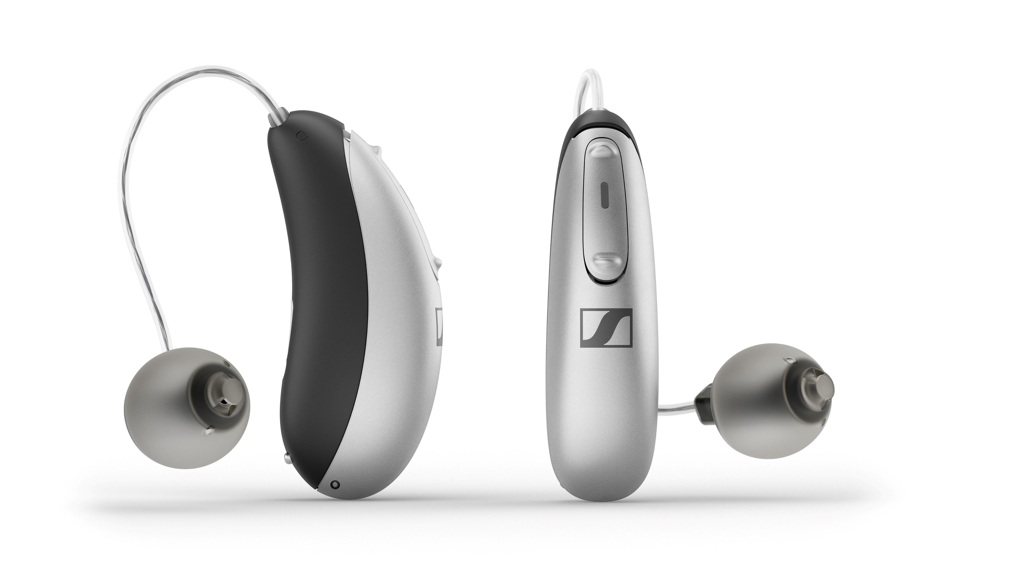
All-Day Clear Ready-to-wear Hearing Aids
Designed for the modern consumer
2 Automatic environments
Sold as a pair
Sleek and contemporary designs
Rechargeable
One-size fits most
MFA wireless connectivity
Easyline TV Connector compatible
Set-up via All-Day Clear app by consumer
1 year manufacturer’s service warranty
Standard HCP HA return policy
Comprehensive online support system
Option for In-Clinic Care Package
All-Day Clear
All-Day Clear Slim
Maximum OSPL90/FOG
110/34 dB SPL
Maximum OSPL90/FOG
109/32 dB SPL

Slide 4
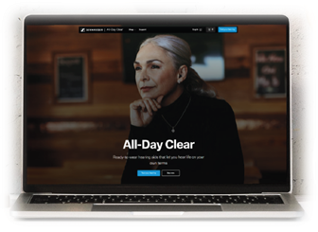
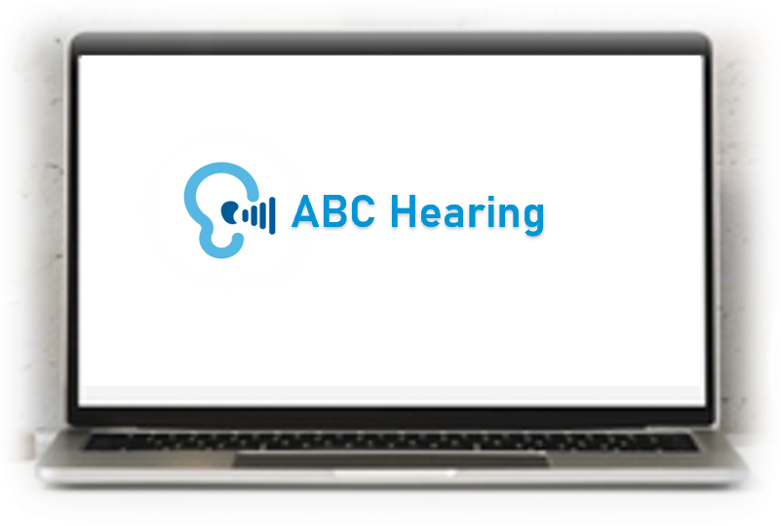
All-Day Clear Online Sales
HCP independent
eCommerce
All-Day Clear Website |  |  | All-Day Clear HCP dedicated webstore
All-DayClear.com |  |  | All-DayClear/ABCHearingClinic.com
Website built, promoted and managed by Sennheiser Hearing Order fulfillment by Sennheiser Hearing All transactions between Sennheiser Hearing and consumer Repairs and returns arranged online by consumers
All-Day Clear
HCP dedicated webstore
All-DayClear/ABCHearingClinic.com
ABCHearingClinic.com
HCP selected at checkout
through Find A Provider tool
ABC pre-selected as provider
No provider locator
  Website built, promoted and managed by HCP
  Order fulfillment by HCP
  All transactions between HCP and consumer
  Repairs and returns arranged online by HCP
$100 commission on All-Day Clear and the lead
$600 margin on All-Day Clear

Slide 5

In-Clinic Care Package
The In-Clinic Care Package takes the All-Day Clear experience to the next level by adding your professional expertise. Available only in clinic, it consists of:
  Minimum one in-person consultation
  Programming with the Unitron TrueFit™ Software
  An additional year of manufacturer’s warranty
              Pricing
              MSRP $250
              Unlocking Fee $50
              Margin $200

Slide 6
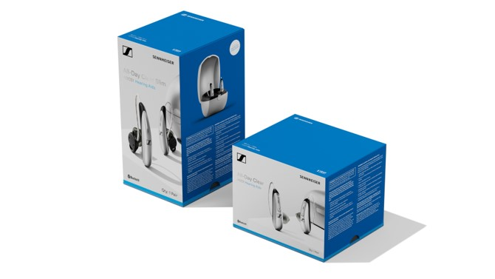
Become an Authorized Dealer
No stock requirements
No minimum purchase expectations
All-Day Clear agreement
  Advertise the hearing aids and In-Clinic Care Package at MSRP
  Offer the In-Clinic Care Package for purchase in-clinic
  Input clinic information for us to create a webstore –takes around 5 minutes
All-Day Clear Slim
All-Day Clear
MSRP | $1499.95
List Price | $ 899.40
Margin | $ 600.55
MSRP | $1399.95
List Price | $ 839.40
Margin | $ 560.55

Slide 7
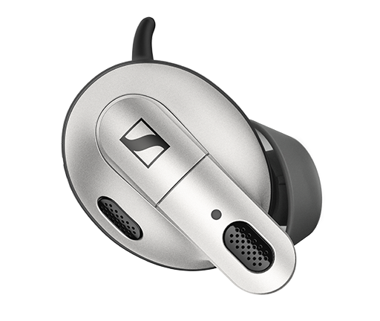



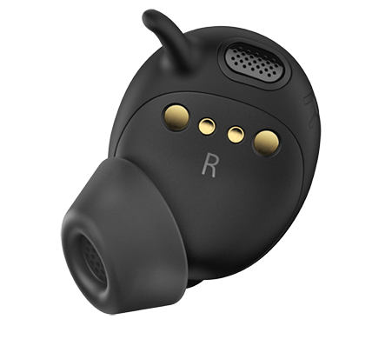


ConC 400
Enjoy clearer conversations
Connect to any
Bluetooth device
Hear when you want to hear
Excellent
wearing comfort
Easy set-up & operation with companion app
Optional TV
connector
Maximum OSPL90/FOG
100/20 dB SPL
List Price = $570
Notes:
Speech enhancement and active noise cancelling with up to 30 dB of noise reduction

Slide 8
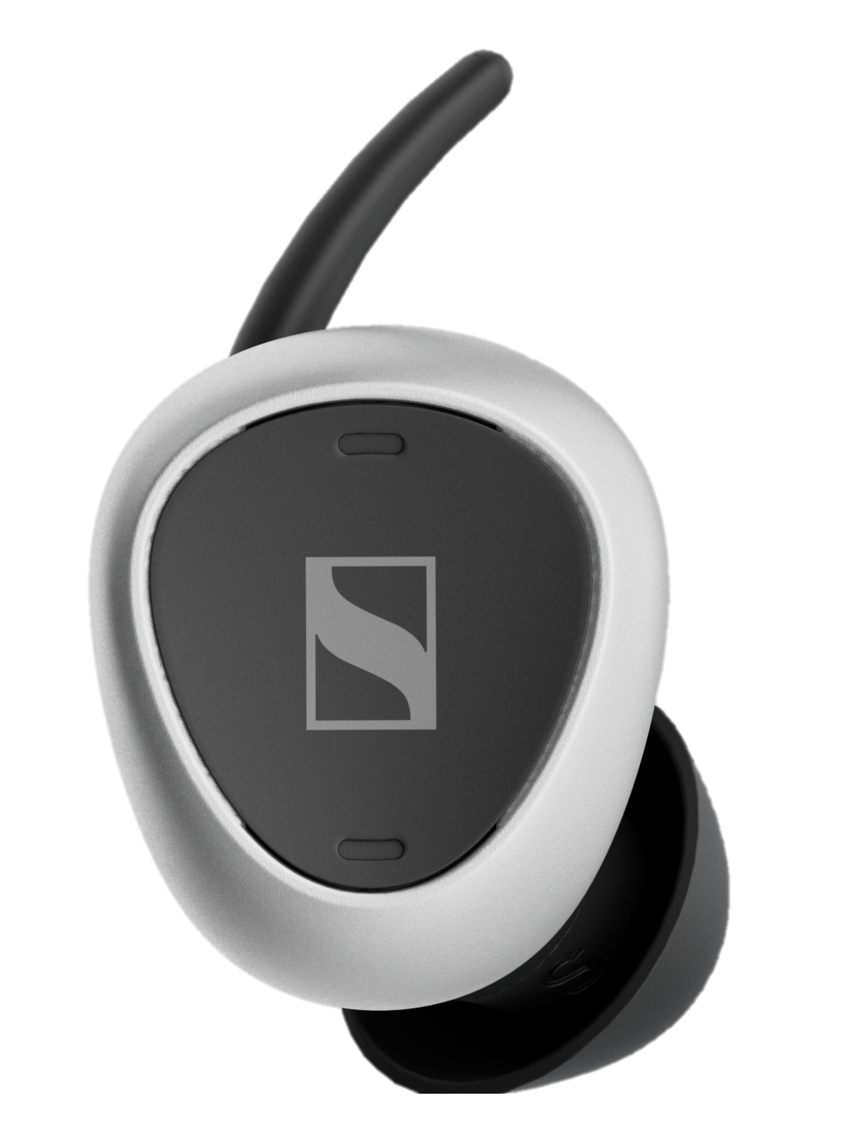
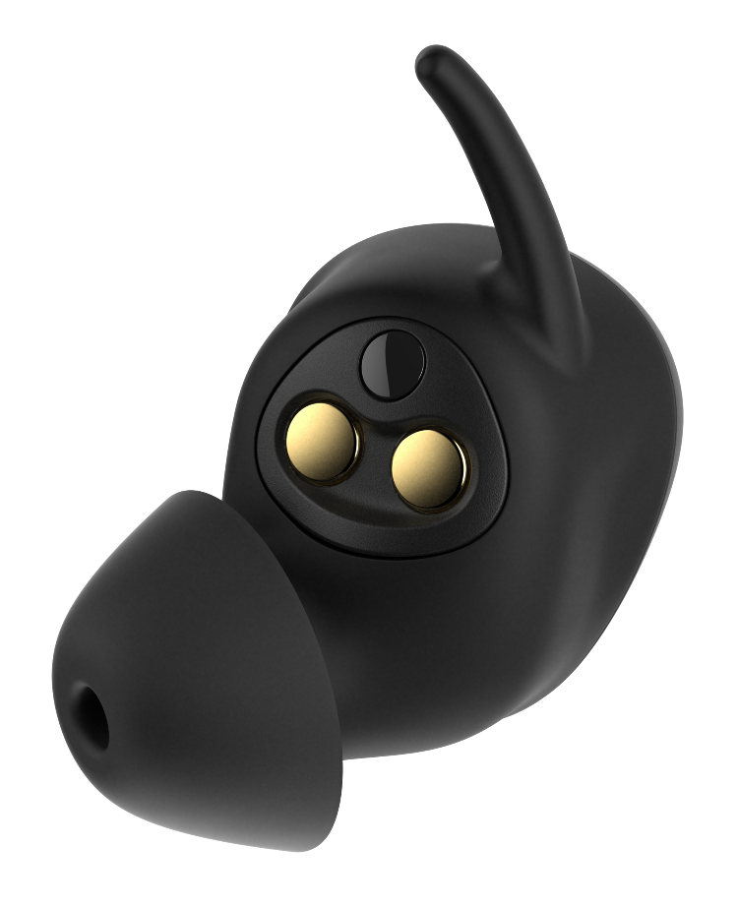
TVS 200 Earbuds
Speech clarity programs
Mobile app
Lightweight wearing comfort
High-definition sound
Connect to any
Bluetooth device
12-15 hours of streaming on a single bud charge
TVS 200 Set
TVS 200 Earbuds
List Price $299
List Price $225
Notes:
Included in the TVS 200 Set
Double bandwidth for superior audio performance
Analog & Dolby compatible optical input
Excellent stereo sound quality
Dedicated TV and audio interface for compatible headphones, offering great listening experience*
A proprietary transmission technology optimized for low latency and power consumptions

Slide 9
Sennheiser Opportunities
$600 margin for All-Day Clear sold in-clinic and HCP website​
$200 margin on the In-Clinic Care Package ​
$100 margin on TV Connector​
$100 commission on webstore sales
Unlimited opportunities for diagnostic and follow-up services​
Potential for future hearing aid sales ​
Establishing relationships and future referrals

Slide 10

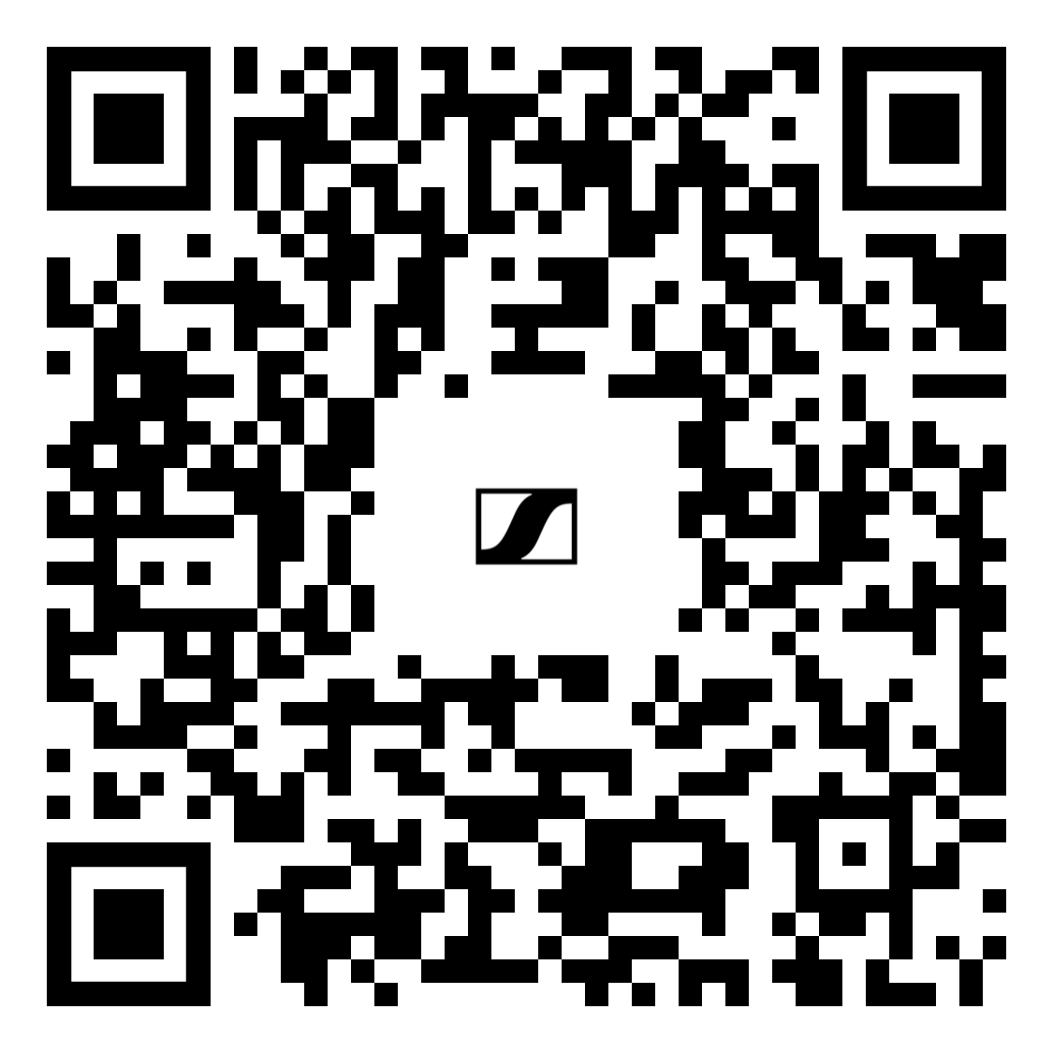
Take out your phones
Sennheiser Hearing Support
Dedicated to supporting you and your consumers.
Phone: 866-435-5646
Hours: Monday to Friday
8:00 am – 4:30 pm CST
HCP email:
SHSUS@sennheiser-hearing.com
Consumer email: support.alldayclear@sennheiser-hearing.com
Request a free starter kit
Learn more
Contact us
Notes:
Here are your QR codes.
The number one way you can get information in you hands

Slide 11
Thank you.
Contact for more information
Sennheiser Hearing Support
866-435-5646
SHSUS@sennheiser-hearing.com
Sennheiser Hearing Resources

